Slide 1
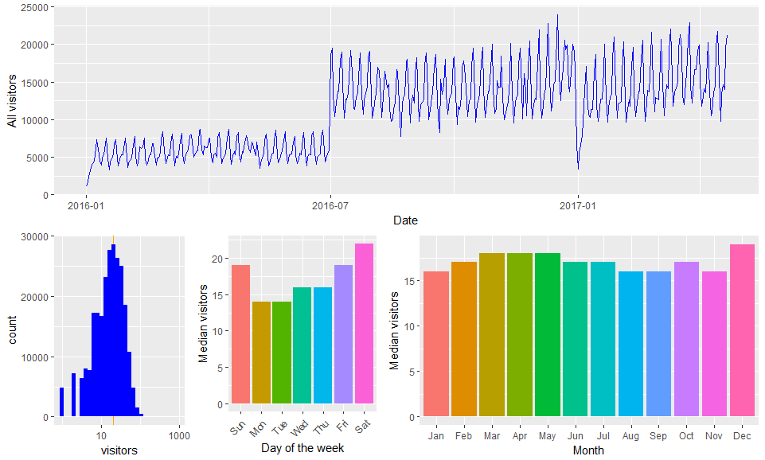
Preliminary Findings – Air Visitors

Slide 2
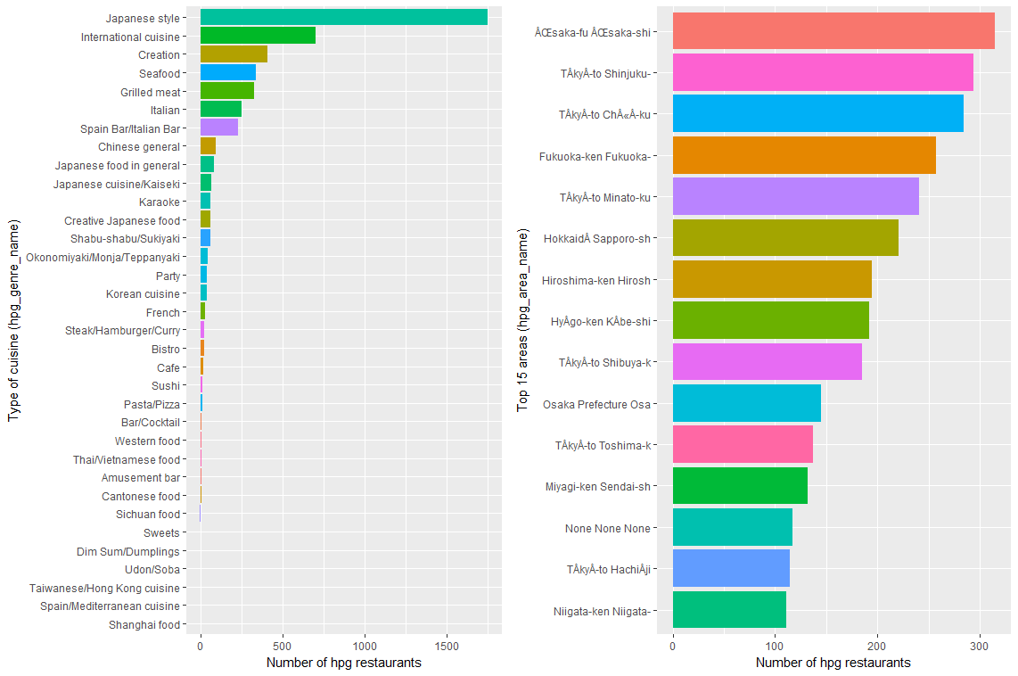
HPG visitors by genre name and areas

Slide 3
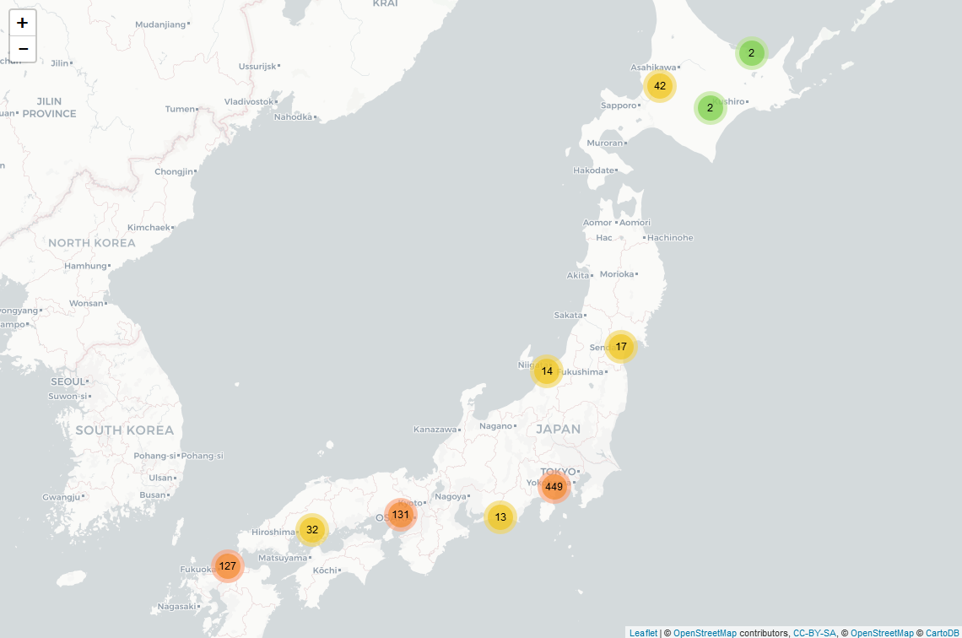
Air visitor heat map

Slide 4
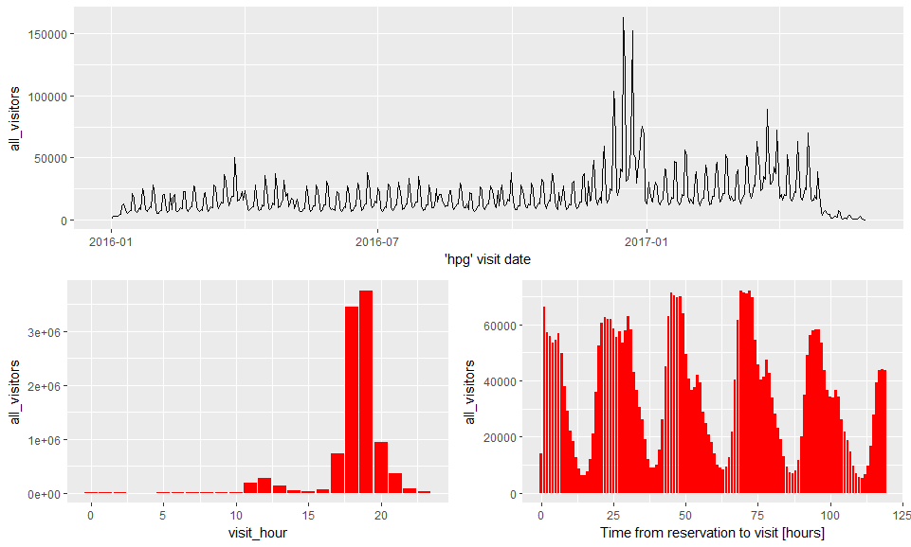
Preliminary HPG visitor trend

Slide 5
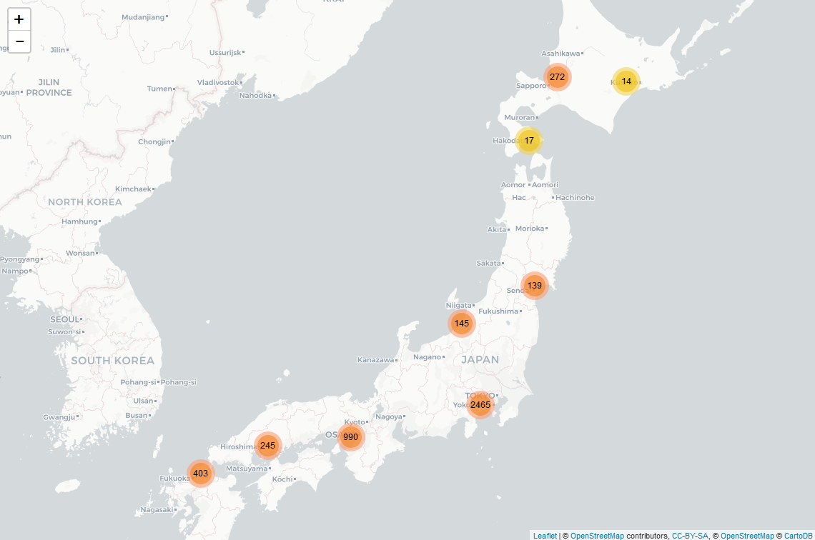
HPG visitor heat map

Slide 6
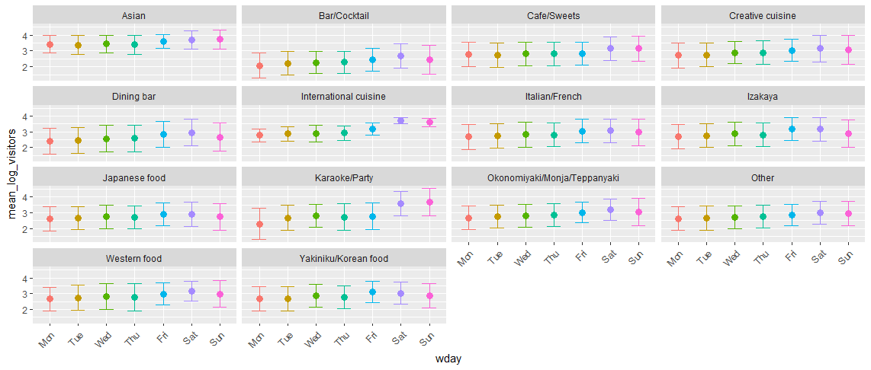
Al
All visitors by genre and week days

Slide 7
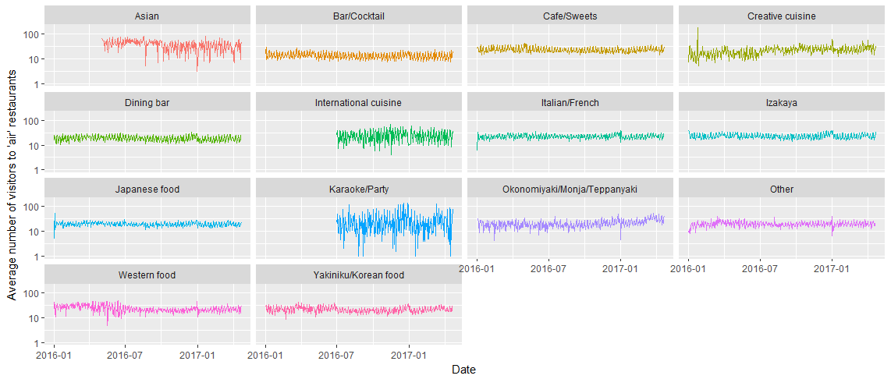
Preliminary Findings – Areas of hpg stores

Slide 8
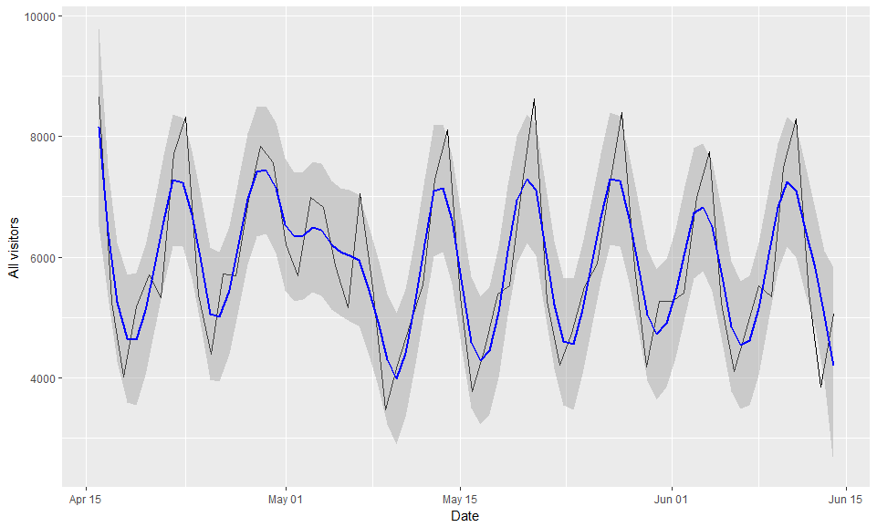
All visitors – forecast period from previous year

Slide 9
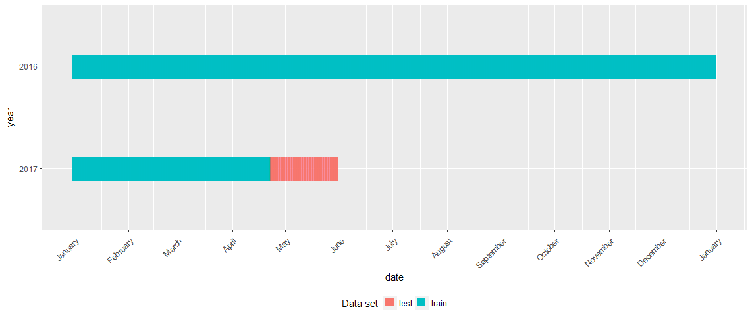
Training period vs test period

Slide 10
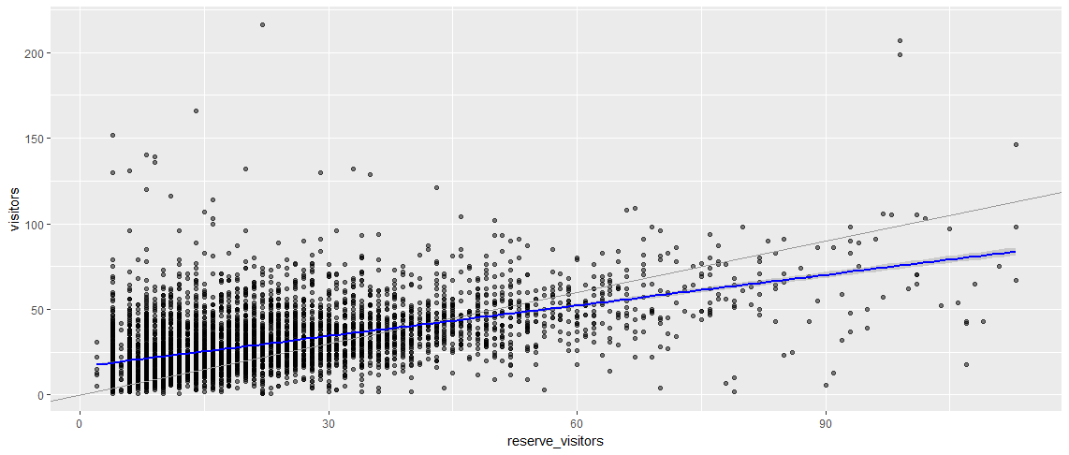
Visitor versus reservation visitors

Slide 11
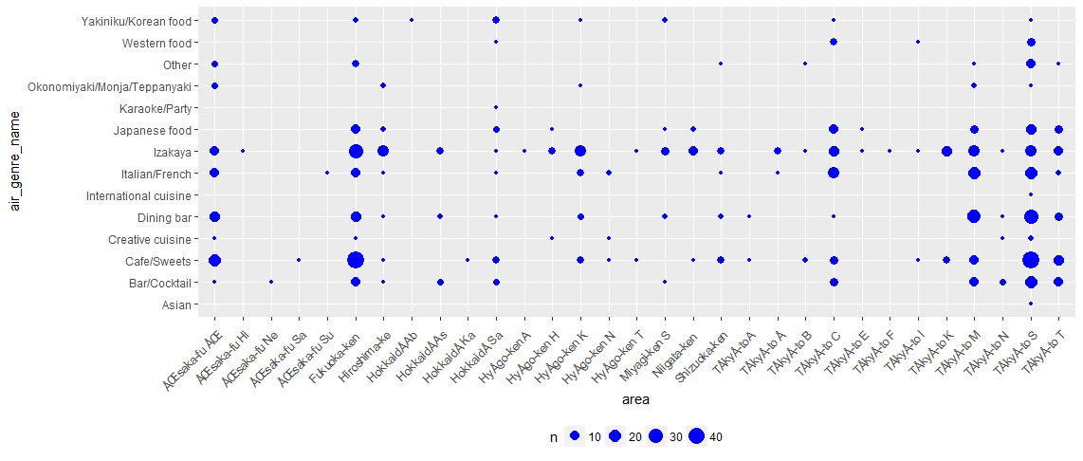
Air genre vs area vs visitor size

Slide 12
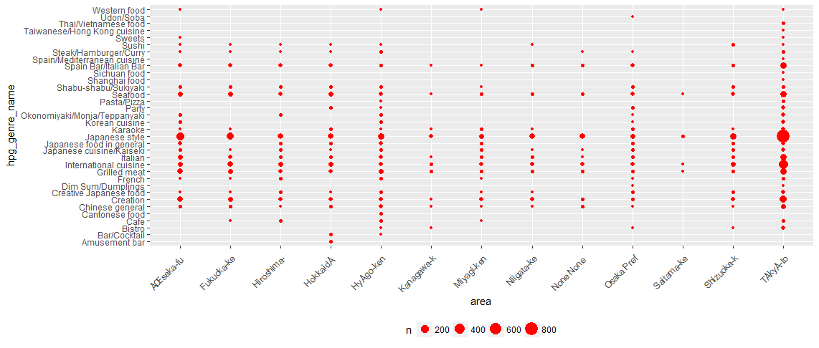
HPG genre vs area vs visitor size

Slide 13
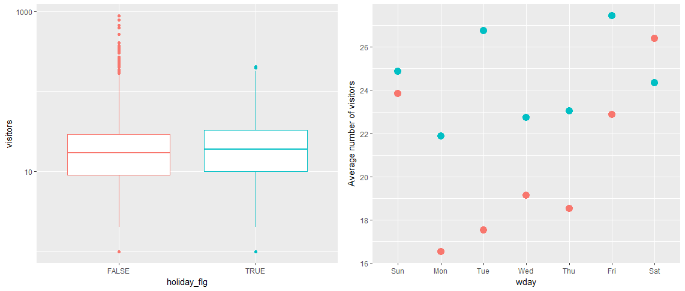
Impact of holidays on visitors

Slide 14
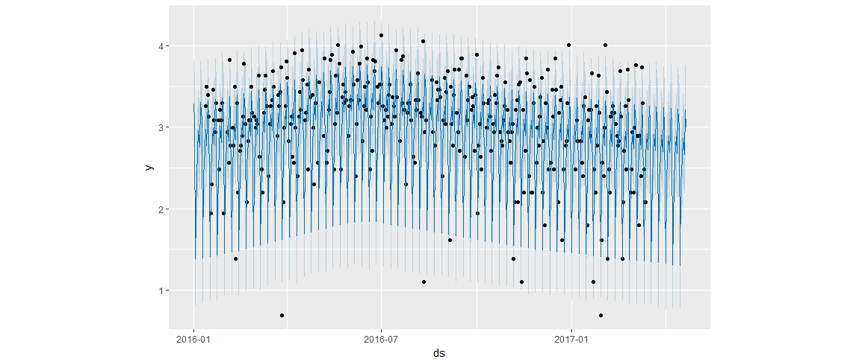
ARIMA forecast for restaurant ID

Slide 15
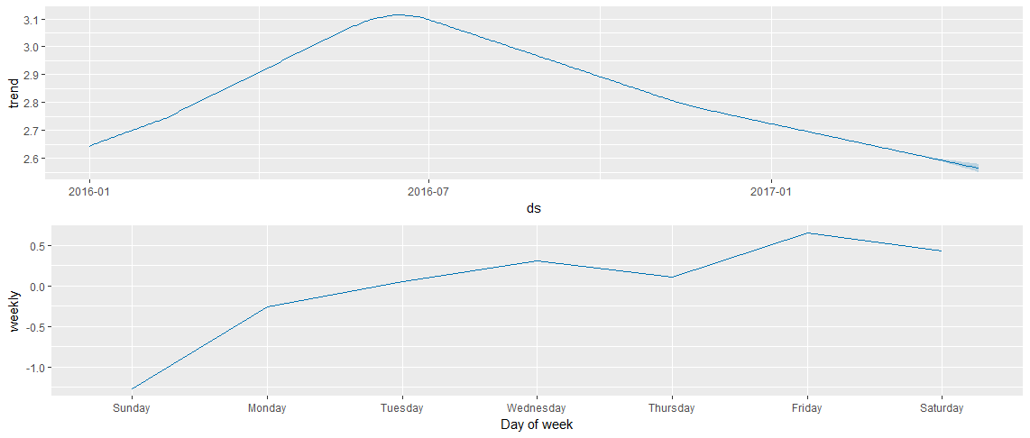
ARIMA Decomp

